Slide 1

National Pediatric Pneumonia Healthcare
Vega Shetty

Slide 2
Problem Statement
According to WHO statistics, pneumonia remains the single biggest killer of children under 5 globally, claiming the lives of more than 1 million girls and boys every year. However, the disease is treatable and preventable. Accurate and early detection of the disease is key.
Community health workers who have limited medical training and must accurately determine respiratory rates in children as part of diagnosing pneumonia.
Hence a sophisticated device to track vitals is necessary!

Slide 3
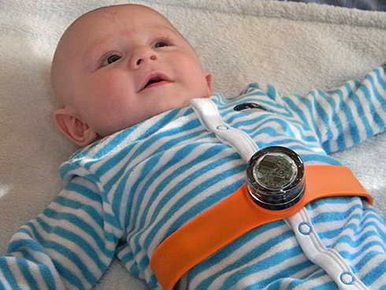
The Sensor device
An Infant Respiratory Rate Sensor device has been developed by Inspire Living organization through their efforts in smart object sensing and pattern recognition.
This device is specifically designed for use by community health workers who have limited medical training
Using the vitals recorded by this device, we can get the health information from remote areas.

Slide 4
Proposed Solution
The National Pediatric Pneumonia Healthcare application will use the Infant Respiratory Rate Sensor device to get information regarding the vital signs of a child in any remote area.
Based on the analysis of the vital signs obtained, the application will detect if the signs are abnormal and the child requires treatment for pneumonia.
This application will help provide pediatric healthcare in remote areas and reduce mortality rate. It will also give healthcare statistics of a particular community and help the government concentrate on eradicating pneumonia in those areas.

Slide 5
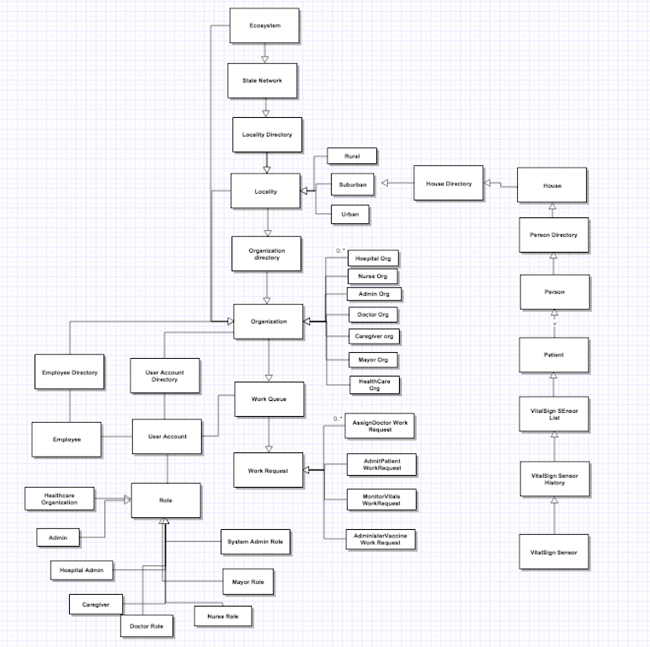
Object Model

Slide 6
Roles
Application System Administrator
Locality Admin
Health Care Organization Admin
Caregiver
Hospital
Doctor
Nurse
Mayor

Slide 7
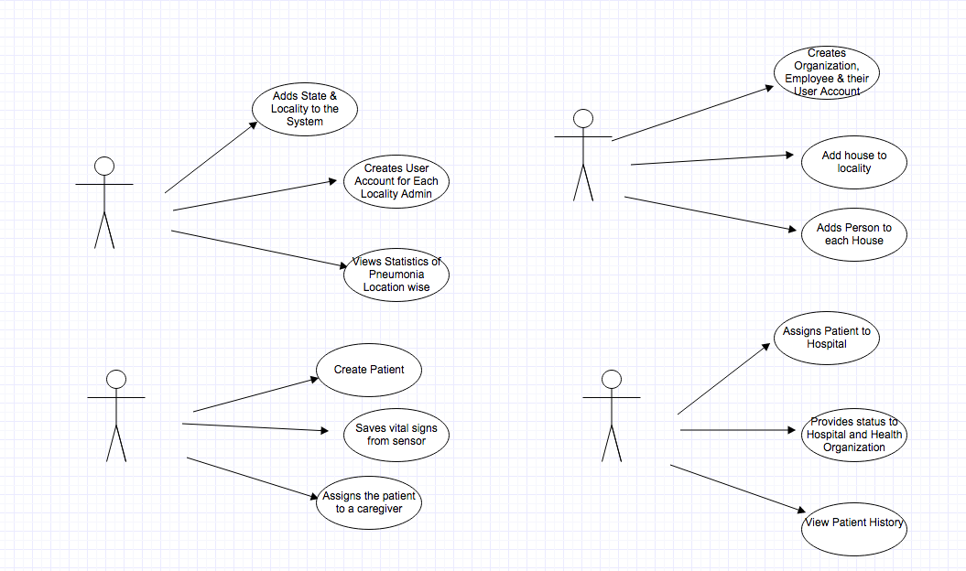
Use case

Slide 8
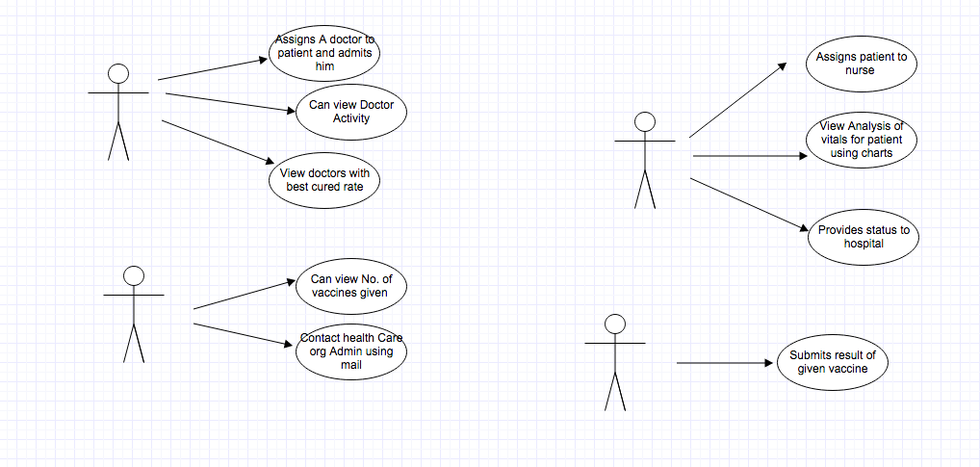
Use Case

Slide 9
Features of application
Uses IoT and a sensor device to effectively store vitals for kids suffering from pneumonia.
Ensures end-to-end management for a pediatric patient and provides doctors with visual charts to monitor vital signs history
Allows the mayor of a locality to ensure that vaccines are administered and email the healthcare organization chief if needed.
User communication between organizations at every level
View statistics for types of different localities.

Slide 10
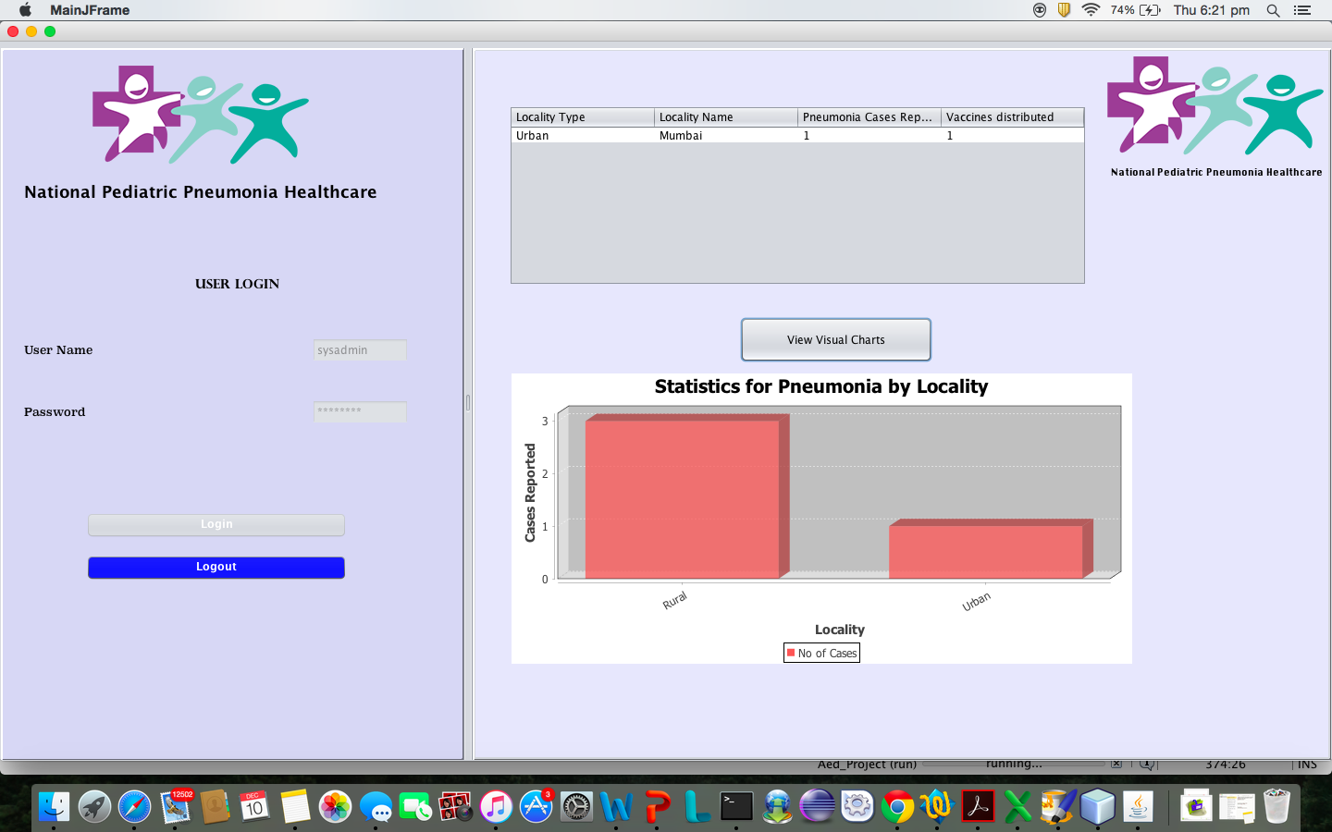
Analytics

Slide 11
API’s Included
Java mail API-
-Mayor can mail the health organization chief
JFreeChart Api-
- Provides locality wise statistics for pneumonia
- Provides charts of vital signs of a patient
Db4o Util API

Slide 12
Thank You

